Slide 1
UML
Use Cases to Class Diagrams
Ciaran O’Driscoll

Slide 2
MODELING WITH UML - INTRODUCTION
UML
  offers a well defined syntax (for object representation/description), well defined semantics (to foster common understanding of notation), and well suited (in broadly describing all aspects of systems under discourse). That is, it is a unified modeling language.

Slide 3
UML ISSUES:
  The concept of modeling objects using UML notations (five key graphical syntactic notations)
  Notations: Use Cases, Class Diagrams, Sequence, Diagrams, Statechart Diagrams, Activity Diagrams, plus management notations: Component and Deployment Diagrams
  Environment or CASE for UML object modeling (Rational Rose and Real-Time Rational Rose)
  Background of UML: Origins in OMT, Booch, OOSE, etc. plus Harel’s state diagrams

Slide 4
System Models (UML notation)
  Functional Model – use case diagrams (synthesized from ‘scenarios’ – from phenomena and concepts)
  Object Model – class diagrams (representing object structures as objects, attributes, associations, and operations)
  Dynamic Model – sequence diagrams, statechart diagrams and activity diagrams (describe the internal behavior or finite state machine of the system). SD are inter-object messaging and interactions, while SC-diagrams depict the finite state machine description of an object’s behavior

Slide 5
2.2: UML OVERVIEW - USE CASE DIAGRAMS
Describe system functionality from external view, uml
  Use cases provide the notation for eliciting and analyzing the functionality
Actors (entities: users, other systems, the operating environment) are entities external to and interact with the system functionality (The use cases)

Slide 6
System Boundaries
The system’s boundary is defined by the actors and the use cases –
  the internals (Represented by the use cases)
  and the external (represented by the actors)
USE CASE DIAGRAMS – Notation for representing the Use Cases, Actors, and the Boundary.
  The Relationship between the Use Cases and the Actors is represented by the LINKS (or lines)

Slide 7
SimpleWatch
ReadTime
WatchUser
SetTime
WatchRepairPerson
ChangeBattery
Figure 2-1. A UML use case diagram describing the functionality of a simple watch.
The WatchUser actor may either consult the time on her watch (with the ReadTime use case) or set the time (with the SetTime use case).
However, only the WatchRepairPerson actor may change the battery of the watch (with the ChangeBattery use case).
Actors are represented with stick figures, use cases with ovals, and the boundary of the system with a box enclosing the use cases.

Slide 8
CLASS DIAGRAMS
Notation for describing system structure
Each class is an abstraction (containment) of a set of related objects
Classes are ‘linked’ through association, and objects are instances of classes
Class diagrams are specified in terms of:
  Objects, classes, attributes, operations, and associations

Slide 9
Class Associations
Classes are interconnected by associations (labeled links)
  The numbers, called multiplicities, at the two ends of the link indicate the number of associations/relationships between the pair of linked classes
Each class is graphically represented as a rectangle of 3 compartments:
  The class-name, The object-attributes, The object-methods

Slide 10
SimpleWatch
1
1
1
1
2
1
2
1
PushButton
Display
Battery
Time
Figure 2-2. A UML class diagram describing the elements of a simple watch.
The associations indicate the relationship and the potential number of objects involved in the association.

Slide 11
Sequence diagrams
Used to formalize the behavior and interactions among object classes
Depict or give visual presentation of the flow of communication among the objects in a use case
The diagramming process helps in identifying more participating object, which were missing from the use cases

Slide 12
Sequence Diagram Cont.
Columns in a sequence diagram represent:
  The actors (typically, the leftmost column) that interact with that use case
  Objects that participate in that use case (object names are underlined)
  Labeled arrows that indicate the ‘stimuli’ or message an object sends to other objects

Slide 13
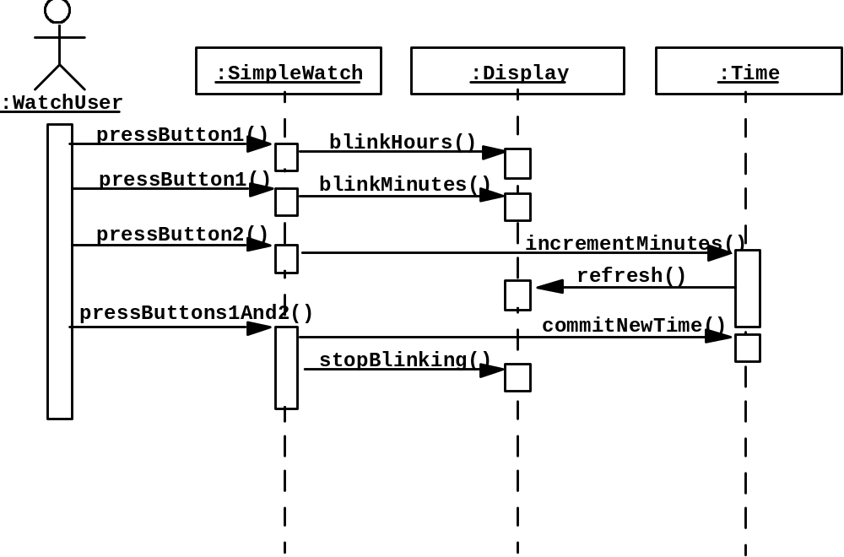
Figure 2-3. A UML sequence diagram for the SimpleWatch.
The leftmost column represents the timeline of the WatchUser actor who initiates the use case.
The other columns represent the timeline of the objects that participate in this use case.
Object names are underlined to denote that they are instances (as opposed to classes).
Labeled arrows are stimuli that an actor or an object sends to other objects.

